Slide 1



LondonAirBNB
Price Prediction Using Regression Models
Shai
Lara
Sharon

Slide 2


The business problem
Figuring out the price of a listed Airbnb rental is an important and
difficult task for both the host and the customer. This price prediction
regression task can also have multiple downstream uses, such as in
recommendation of similar rentals based on price.
Customer
Host
For the former, it can enable them to set a reasonable price without compromising on their profits.
For the customer, it helps understand the key drivers for price and provides them with similarly priced places.

Slide 3

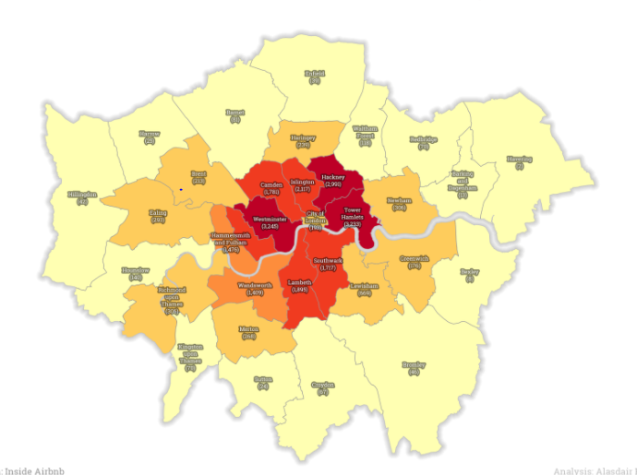
The data
set
Data was taken from Kaggle - https://www.kaggle.com/jinxzed/londonairbnb
supervised learning regression
48 columns, 48, 83689 non-null rows
multiple types of variables: numeric
and text
The price per night will be the target
vector
Mean Absolute logarithmic Error as the evaluation
metrics (RMSLE)
Notes:
Target variable
select listings priced between 15 and 900 gbp
Evaluation Metrics
Root Mean Square Error (RMSE) - standard deviation of the residuals (prediction errors).
Residuals are a measure of how far from the regression line data points are.
RMSE is a measure of how spread out these residuals are. In other words, it tells you how concentrated the data is around the line of best fit.

Slide 4


The pipeline
EDA
Modelling
Data-set
improvement

Slide 5



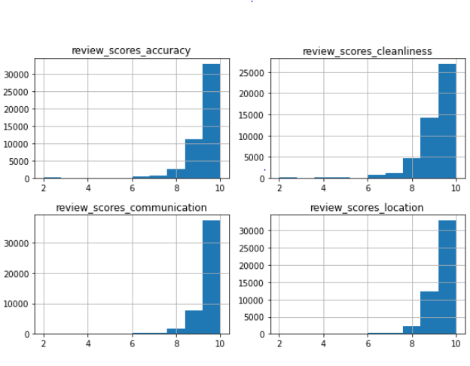
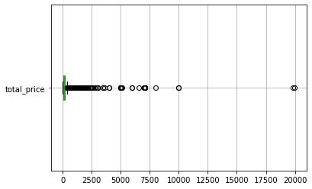
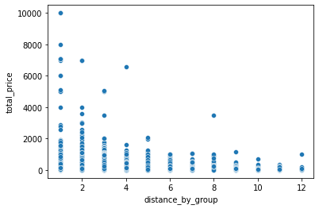
EDA
Remove
Combine
Transform
Combining all reviews columns to a single average column as all reflect similar behavior
Uniting 'Hotel1' and 'Hotel2' property types to a single 'Hotel' type column
Removing low variance features and null values rows
Remove outliers
Transforming host acceptance rate into a categorical feature, rather than a numerical one. transforming distance to radius from center jump by groups of 2.5 [km].
Getting One-hot encoding for categorical columns
Adding price column with cleaning fee column to a single total price column

Slide 6
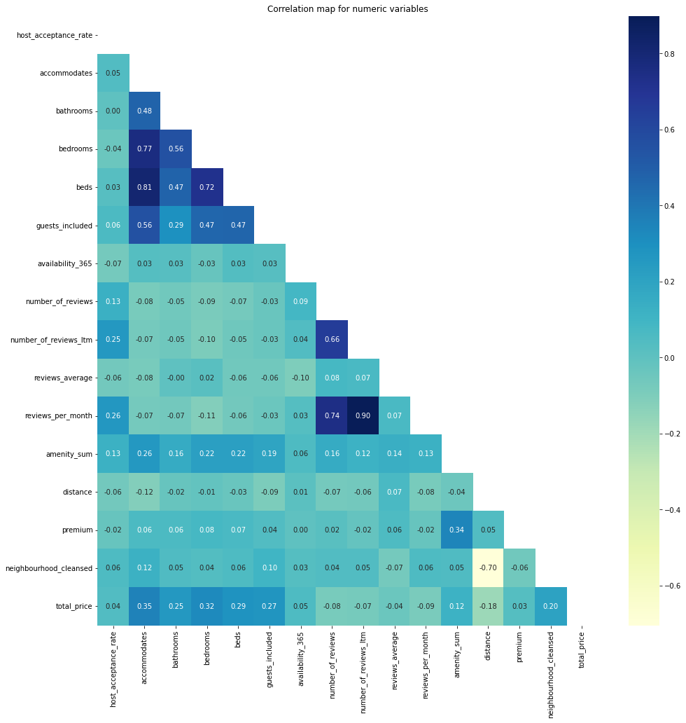
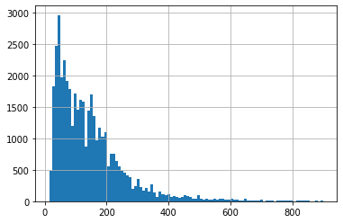
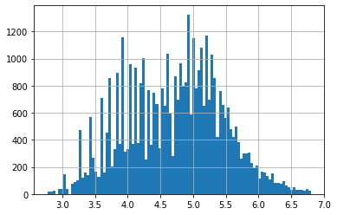
The Chosen Features
Scale price to log scale
host_acceptance_rate
accommodates
bathrooms
bedrooms
beds
guests_included
availability_365
reviews_average
reviews_per_month
number_of_reviews
distance_by_group
host_is_superhost
host_has_profile_pic
neighbourhood_cleansed

Slide 7

Model scoring after Improvement
 | Linear Regression | Decision Tree | K-Nearest Neighbors
Features | Numerical, Binary/Grouped (17, 3) (7 Interaction features) | Numerical, Binary/Grouped (9, 0) | Numerical, Binary/Grouped (14, 3)
HyperParameter #1 |  | Maximum depth of tree (d =7 ) min_samples_leaf (s = 4) min samples split (p = 3) max leaves nodes (m = 100) | Num of neighbors (k = 12)
HyperParameter #2 |  |  | matrics: manhattan(all the numbers are between 0-1 so manhattan work a little better
RMSLE test | 0.47 | 0.31 | 0.54
RMSLE improved | 0.44 | 0.19 | 0.41

Slide 8
Model scoring after
improvements
39%
24%
6%
RobustScaler
MinMax
MaxAbs
Polynomial
MinMax
LR
DT
KNN
Notes:
ערכים אחרי שיפור:
LR= 0.44, 0.46
DT = 0.18,0.19
KNN = 0.39, 0.41

Slide 9

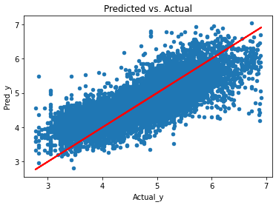
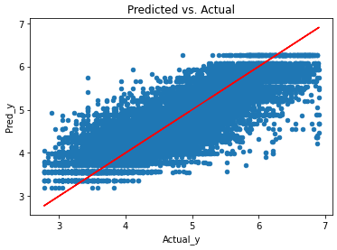
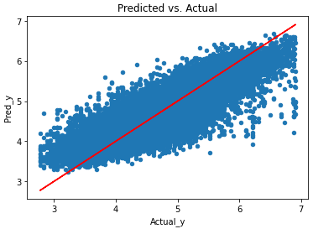
Conclusions & challenges
Scaling was impactful for DT & KNN, and essential for LR for interaction features analysis
Feature selection:
Some features which may seem effective weren’t so (reviews_avg, number of reviews)
distance vs. neighborhood - location correlation as distance from center vs. neighborhood reputation
Outliers handling - custom vs. RobustScaler
Feature engineering:
scaling log_price was not intuitive for our problem
LR Improvement using PolynomialFeatures selectively
LR
DT
KNN
Notes:
Feature selection - some features which may seem impactful weren’t so - reviews, not only distance but the popularity of the neighborhood
scaling log_price - not intuitive for our problem

Slide 10
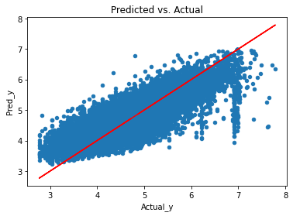
Main Difficulty within the Pipeline
we had difficulty with one part of the prediction (in purple )
we tried a lot of difference combination to find the root cause , around log(7) but nothing stand out.

Slide 11
Thanks!
Any questions?

